Slide 1
The Dweller Left Adrift
No main menu image yet ☹
Made by: James K. Philip D. Vinh M.

Slide 2
About the project
The game has a Metroidvania style. (In which involves a huge map with your screen scrolling).
It Includes a lot of mechanics (gravity, jump, dash, attack etc.)
It has Pixel Art style.
It has 3 Levels, the First Level is a Tutorial, the second and third levels are normal gameplay.

Slide 3
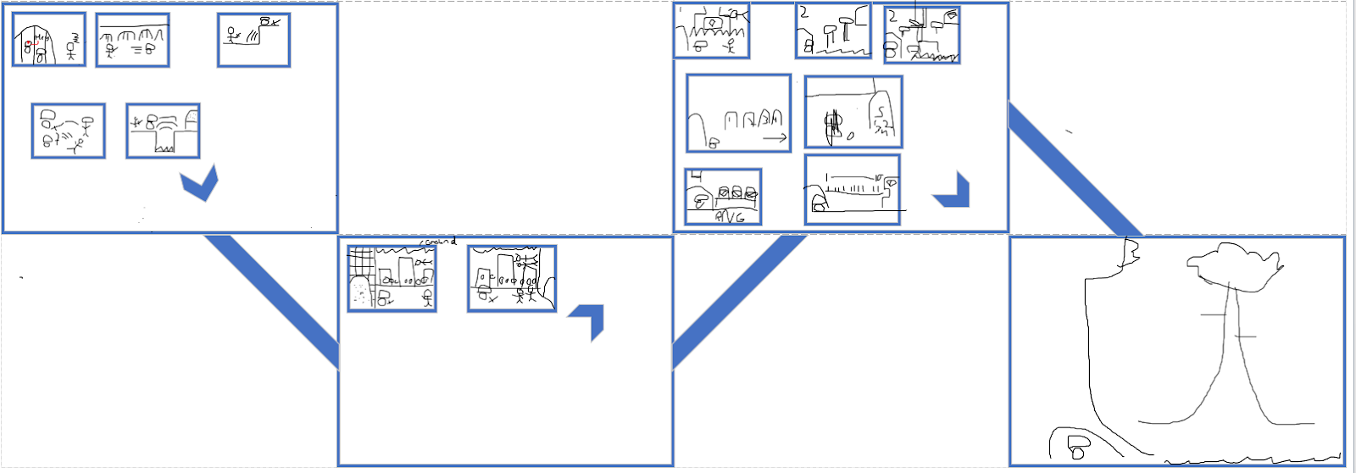
Map Layout

Slide 4
Roles and Achievements
James K. -Group manager, GDD, World Designer, Text Dialogue, Programmer,
Philip D. -GDD, Level Designer, Some Pixel Art, Menus, Programmer,
Vinh M. -Head Programmer, Develop many mechanics,

Slide 5
Demonstration
In class

Slide 6
Interesting codes
Jumping on and off a platform.
Platform collisions
Scrolling world.
Text Dialogue.
Menus mechanic.

Slide 7
What is next?
Add the characters/level/Menu Pixel Art design.
Introduce Attacks: light attacks and heavy attacks, with a cooldown for heavy.
Introduce Enemies AI to make them move and/or attack depending on the player`s location
Due to time, we might only do 1 to 2 Levels.(Tutorial and Ants` City).
Add sounds to the characters and world level depending on the action(character) / world (level).

Slide 8
Problems and issues?
It is the almost the end of the semester, other courses assignments makes us have less time to work on the game.
The collisions still creeates certain problems. It still does work as a floor but teleports you up when the player touches the side of it.
The health bar still encounters some issues with switching between

